Slide 1
RecipeCart
College of Engineering and Computer Science
Group 35

Slide 2



Team Members
Darren Ha – CpE
Quan Nguyen – CpE
Bryan Ha – CS

Slide 3
Context and Purpose
Food waste accounts for 30-40 % of the food supply in the U.S.¹
Uneaten food accounted for roughly 38 % of the U.S. food supply in 2021
Purchased groceries rarely reflect true magnitude of consumer’s needs
Often leads to surpluses going past expiration and into the garbage bin
Encourage usage of leftover ingredients by recommending recipes given a user’s current ingredient inventory
Implemented through a minimalistic, streamlined process to bring food items from the kitchen table to a mobile platform
Enable integration with existing IoT technologies such as smart shopping carts and smart fridges
https://www.bloomberg.com/news/articles/2023-04-20/the-us-has-a-food-waste-problem-and-it-s-getting-worse?embedded-checkout=true
Notes:
Changelog:
Added last bullet regarding enable integration with existing IoT technologies

Slide 4
Goals and Objectives
Primary Goals
Detect physical ingredients based on barcode and image data
Output a list of recipes corresponding to a list of available ingredients
Front a mobile interface for users to view outputs
Advanced Goals
Integrate a weight system into the RecipeCart
Detect ingredients via video stream input rather than through image snapshots
Integrate an AI recipe generation system
Objectives
Integrate a barcode detection system
Integrate a image classification model to classify ingredients based on vector encoding similarities
Retrieve data from a camera for real time inferencing
Retrieve weight data from a digital scale with minimal noise
Deploy a backend server to perform ML workloads and maintain databases
Create a mobile app for user interaction
Implement a recommendation system to output a sorted list of recipes

Slide 5
Design Specifications and Constraints
Ingredient Detection Time | < 5 seconds | Broadcast Delay | < 2 seconds
Classification Accuracy | > 80 % | Product Weight | < 4 kg
Recipe Recommendation Time | < 5 seconds | Power Consumption | < 10 watts
Minimum Recipe Output | > 1 recipe | Budget Management | < $400
Absolute Weight Error | < 20 grams
Figure 1. Design Constraints Table

Slide 6
Hardware Comparisons

Slide 7
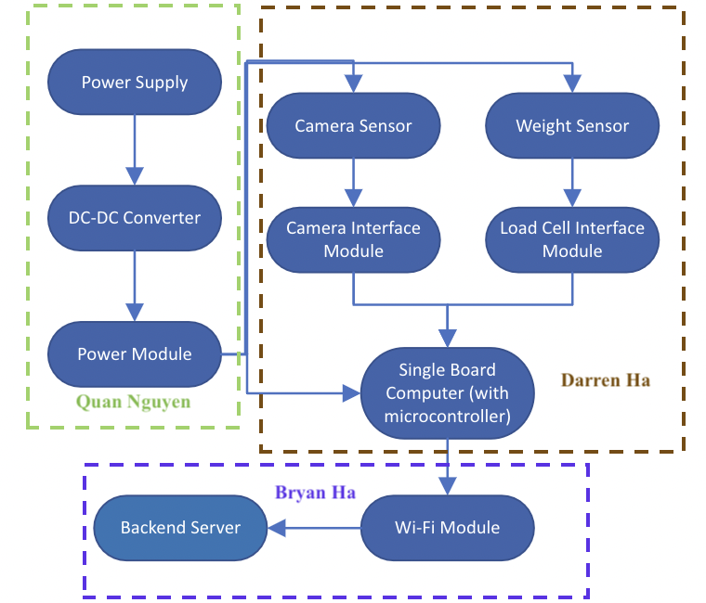
Figure 2. General Hardware Block Diagram
Notes:
Todo: update block diagram

Slide 8
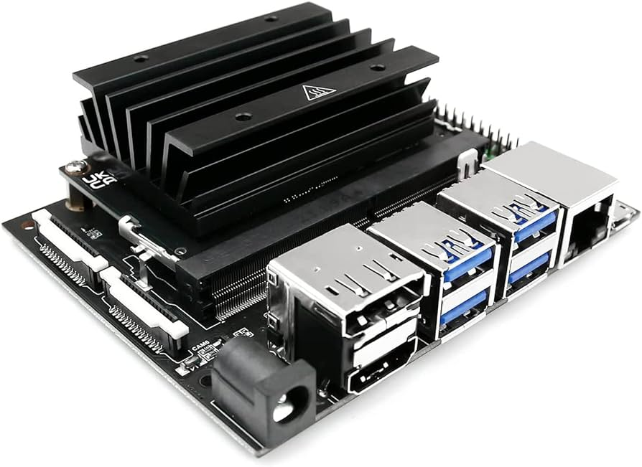
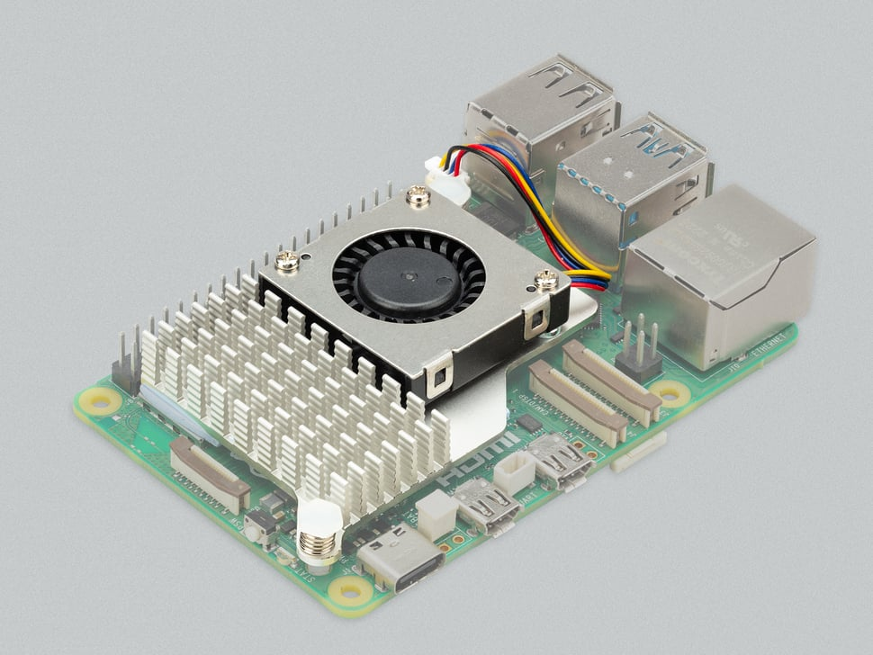
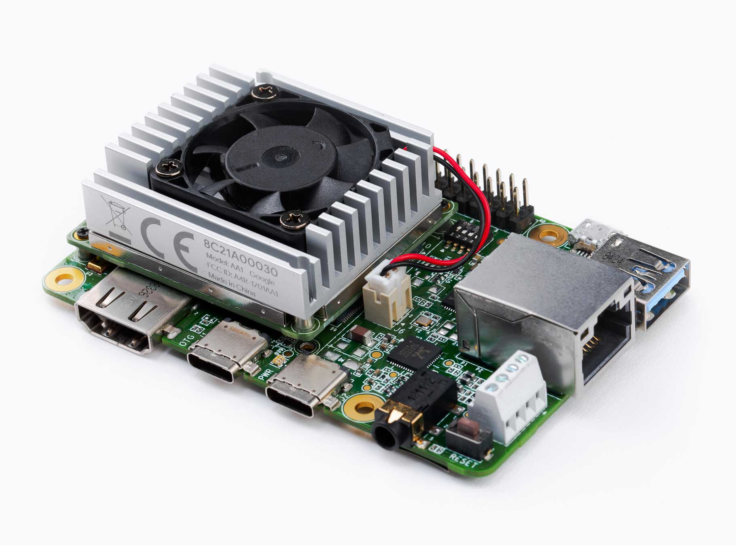
Single Board Computers
Name | Raspberry Pi 4 / 5 | Coral Dev Board | Jetson Nano
CPU | Quad-core ARM Cortex-A72 / Cortex-A76 | Quad-core ARM Cortex-A53 + Cortex-M4F | Quad-core ARM Cortex A57
GPU | None / VideoCore VII GPU | Integrated GC7000 Lite Graphics | 128-core Nvidia Maxwell
TPU | None | Google Edge TPU coprocessor | None
Memory | 1, 2, 4, 8 GB / 4, 8 GB | 1, 4 GB | 4 GB
WiFi Module | Included | Included | Excluded
Power Consumption | 3-10 W | 6-12 W | 5-10 W
Cooling Module | Excluded | Included | Included
Software Compatibility | Most ML libraries | Only with TensorFlow Lite | Most ML libraries
Community Support | Extensive / Sparse | Good | Extensive
Price | $ 60-80 / $ 100-120 | $ 160 | $ 147
Figure 3. Jetson Nano
Figure 4. Raspberry Pi v4
Figure 5. Coral Dev Board
Figure 6. SBC Comparisons

Slide 9
Camera Sensors
Name | Camera Module 3 | HQ Camera | Camera Module 2
Still Resolution | 11.9 Megapixels | 12.3 Megapixels | 8 Megapixels
Video Resolution | 2304 x 1296p56 | 2028 x 1080p50 | 640 x 480p206
Sensor | Sony IMX708 | Sony IMX477 | Sony IMX219
Focus | Motorized (Auto) | Adjustable | Adjustable
Field of View | 75° | Adjustable | 62°
Price | $ 25 | $ 68 | $ 25
Figure 8. USB Camera Comparisons
Figure 7. CSI Camera Comparisons
Name | LogiTech C920 HD Webcam | NexiGo N60 Webcam
Video Resolution | 1920 x 1080p30 | 1920 x 1080p30
Field of View | 78° | 107°
Focus | Auto | Fixed
Price | $ 58.90 | $ 29.99

Slide 10
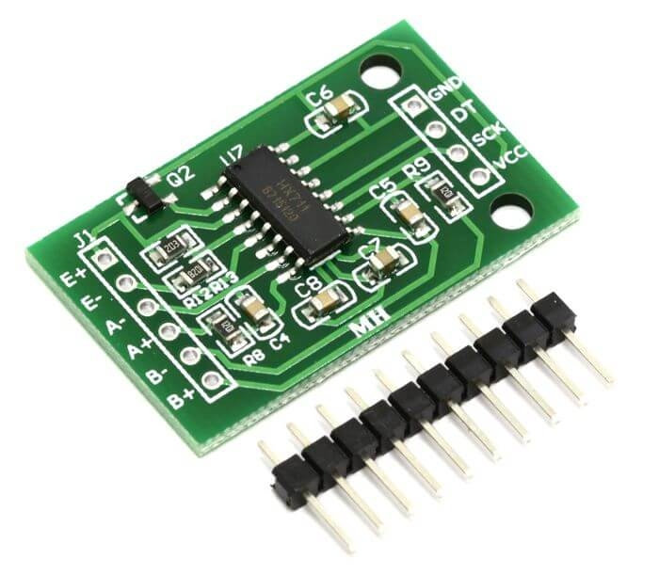
Weight Sensors
Name | HX711 | EK-2000i | TLE
Microcontroller Compatibility | Adapter needed | Native Compatibility | Adapter needed
Programmable | Yes | No | No
Community Support | Good / Extensive Developer Support | Sparse Developer Support | Sparse Developer Support
Additional Resources | Load cell / gauge | None | Load cell
Power Consumption | 1.5 mA | Not Specified - 250 hours battery life | 0-10VDC or 4-20mA output versions
Price | $10.95 | $328.00 | $190.00
Figure 10. HX711 Load Cell Amplifier
Figure 9. Weight Sensor Comparisons

Slide 11
Software Comparisons

Slide 12
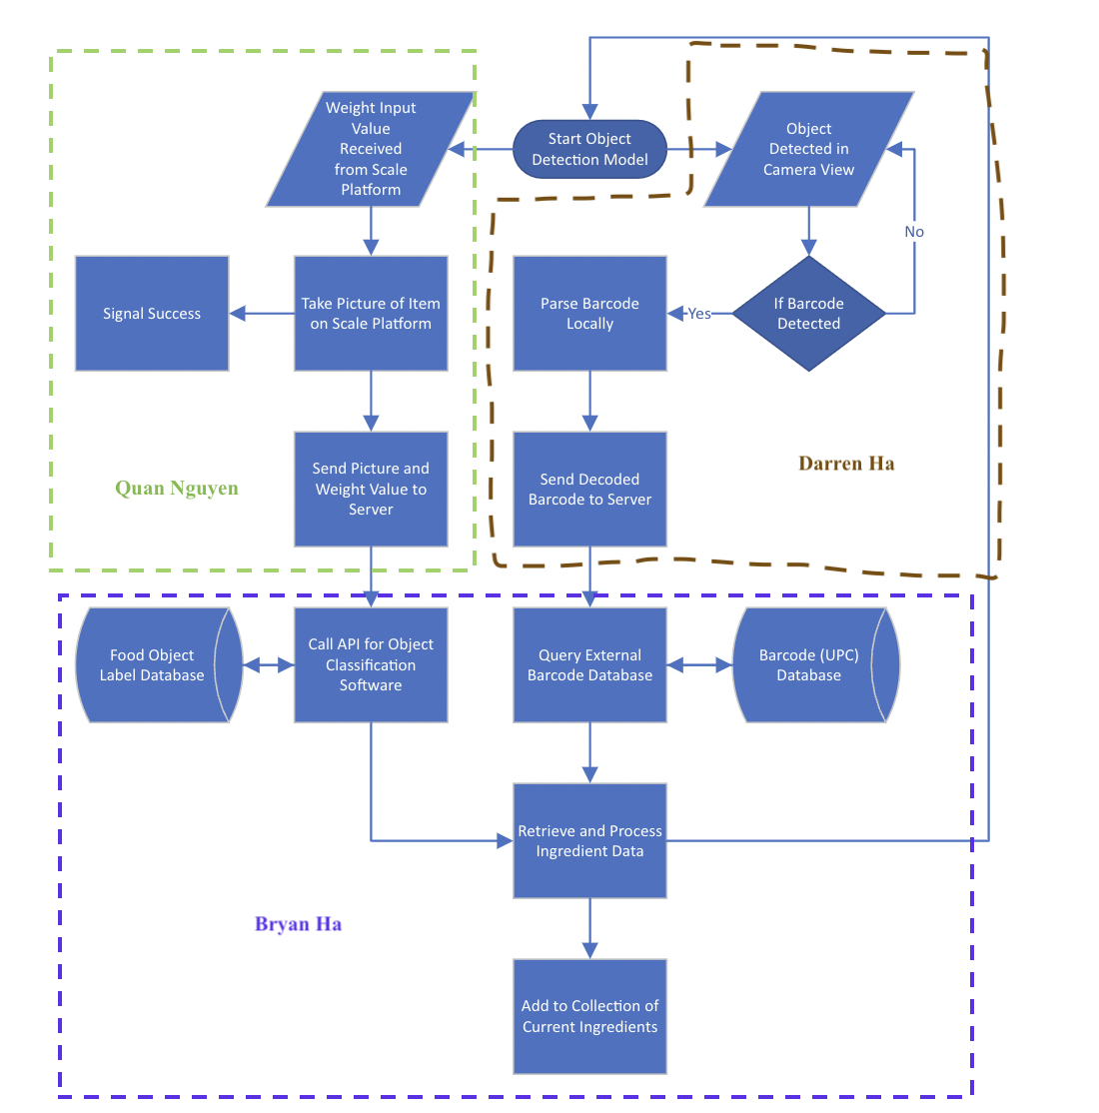
Figure 13. Backend Software Flowchart
Notes:
Todo: update diagrams

Slide 13
Barcode Detection Software
Name | Dynamsoft | DaisyKit | Web API | OpenCV
Price | $100 / month | Free | Free | Free
Implementation complexity | Product ready to go | Product ready to go | Coding detector and requests | Coding detector and decoder
Speed | Enterprise-tier | Slow detector | Slow decoder | Slow overall
Performance | High accuracy | May not detect deformations | Decreased quality due to data streaming | May not detect deformations
Figure 14. Barcode Detection Software Comparisons

Slide 14
Image-based Ingredient Classification Software
Name | Google Cloud Vision | Amazon Rekognition | Meta DINOv2
Flexibility | Classification, Image Segmentation, Image Tagging, etc. | Classification, Image Segmentation, Image Tagging, etc. | Object Detection, Image Segmentation, Image Encoding, etc.
Price | First 1000 / month free, $ 0.0015 / month after | First 5000 / month free, $ 0.001 / month after | Free
Implementation Complexity | Self-contained, complete solution | Self-contained, complete solution | Need to implement a VectorDB
Figure 15. Image Classification Software Comparisons

Slide 15
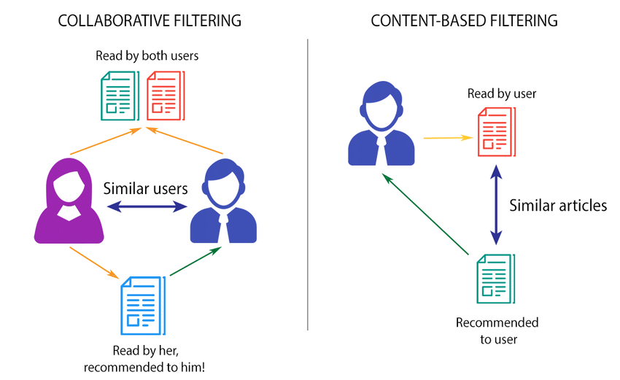
Recipe Recommendation System
Figure 16. Collaborative vs. Content-based Filtering

Slide 16
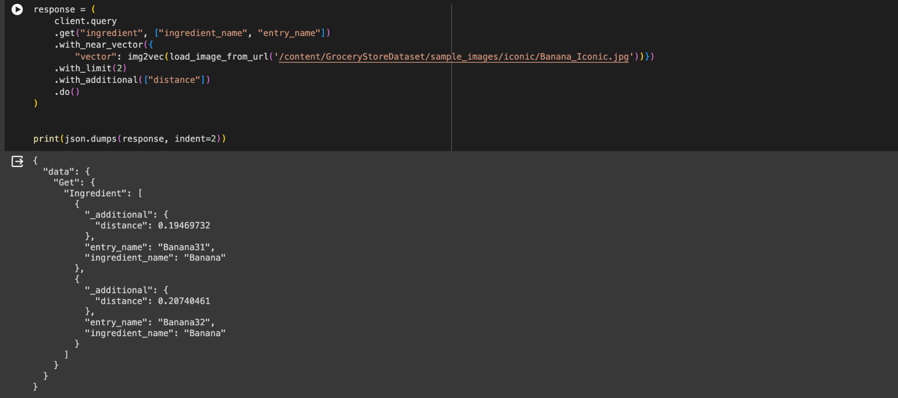
Weaviate Vector DB

Slide 17
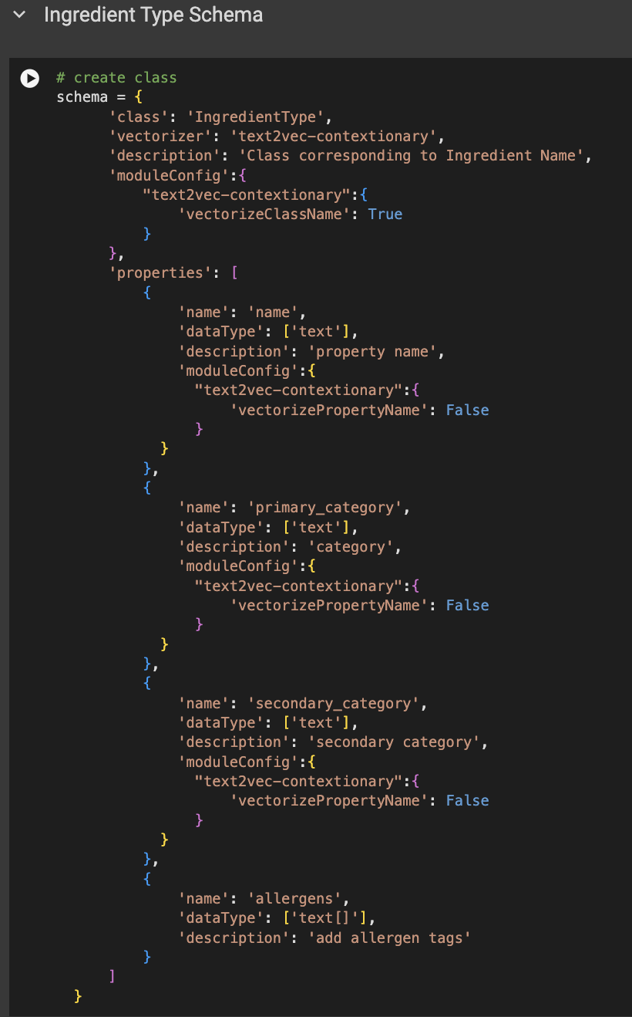
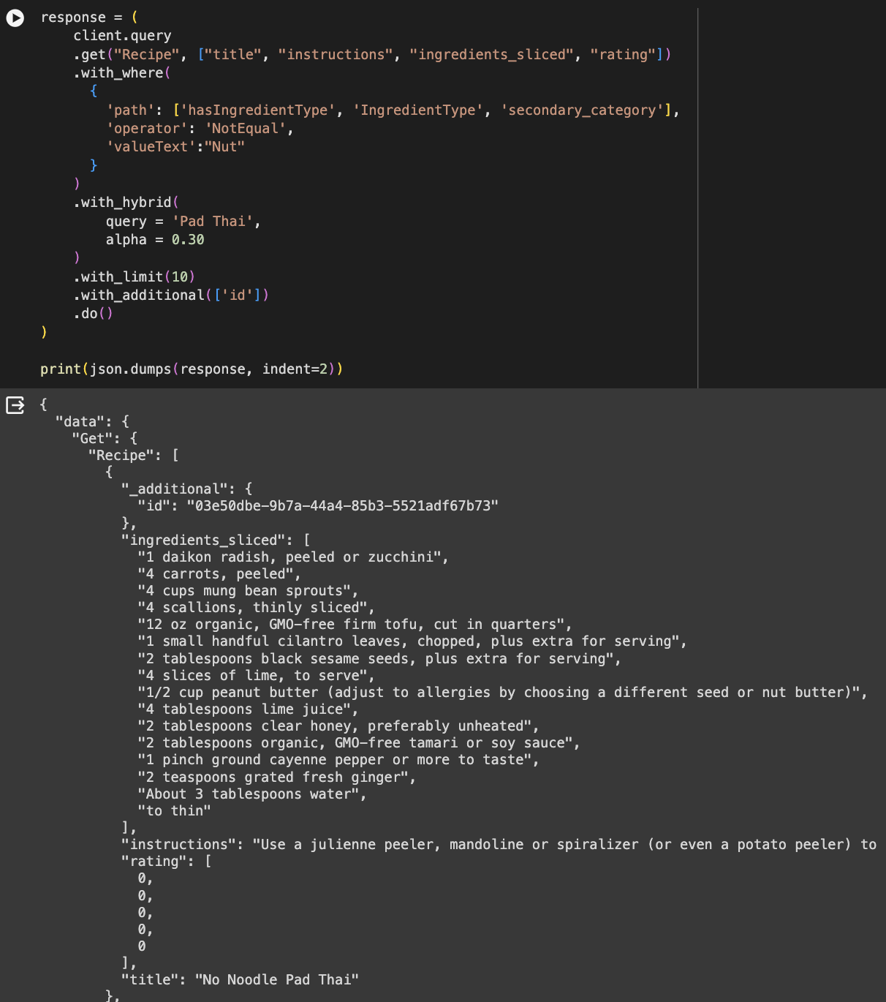

Slide 18
Backend Hosting Platforms
Name | DigitalOcean | Firebase | AWS Amplify | Azure Mobile
Open-Source Compatibility | Yes | Not natively available | Yes | Yes
Custom ML Models | Yes | Not natively available | Yes | Yes
Serverless Options | None | Included | Included | Included
Mobile Development | Must rely on external SDKs | SDKs included | SDKs included | SDKs included
Supported Databases | MongoDB, Kafka, PostgreSQL, MySQL | NoSQL only | Most databases | Most databases
Mobile Testing | None | Included | Included | Included
Complexity | Low | Medium | High | High
Pricing | Starting at $ 7 / month | Starting at $ 12 / month | Starting at $ 14 / month | Starting at $ 18 / month
Figure 17. Backend Cloud Platform Comparisons

Slide 19
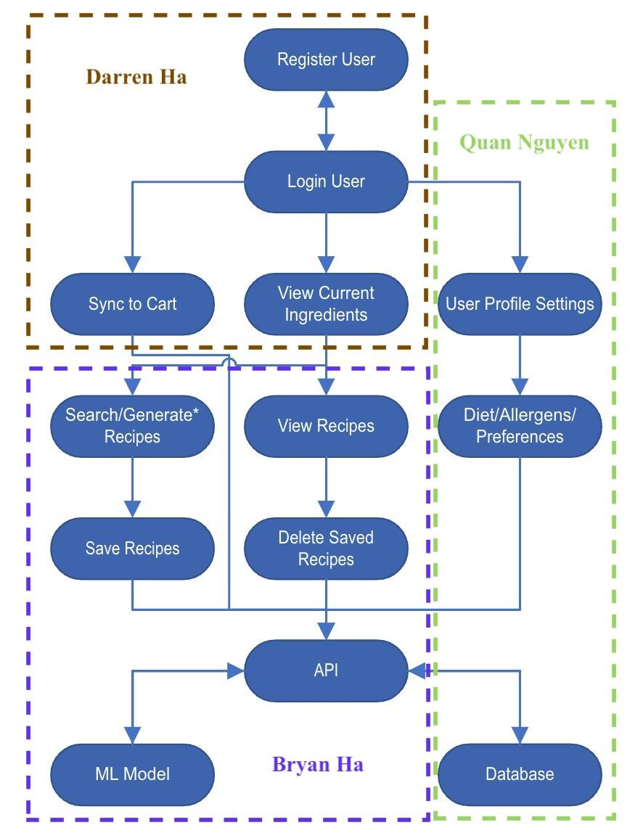
Figure 18. Frontend Software Flowchart
Notes:
Todo: Update Diagrams

Slide 20
Mobile Development Frameworks
Name | Xamarin | Flutter | React Native
Programming Language | C# / .NET Framework | Dart | JavaScript
App Performance | Good, uses native engine | Good, uses native engine | Fair, uses JavaScript engine
Community Support | Managed by Microsoft | Open-source / Extensive | Open-source / Extensive
UI components | Native | Native | Third Party
Figure 19. Mobile Development Framework Comparisons

Slide 21
Databases
Ingredient Database
Weaviate Vector Database for storing ingredient image vectors
World Open Food Facts for populating barcode databank and retrieving product information
Recipe Database
Partially stored in Amazon DynamoDB table (NoSQL managed database solution)
Stored in Weaviate Vector Database for content-based filtering
Loaded from Recipe 1M+ dataset
User Database
Locally stored in Amazon DynamoDB table
Schema established via GraphQL
*World Open Food Facts: https://world.openfoodfacts.org/discover
*Recipe 1M: http://pic2recipe.csail.mit.edu/
Notes:
Maybe add reference url at bottom of slide or at second to last slide

Slide 22
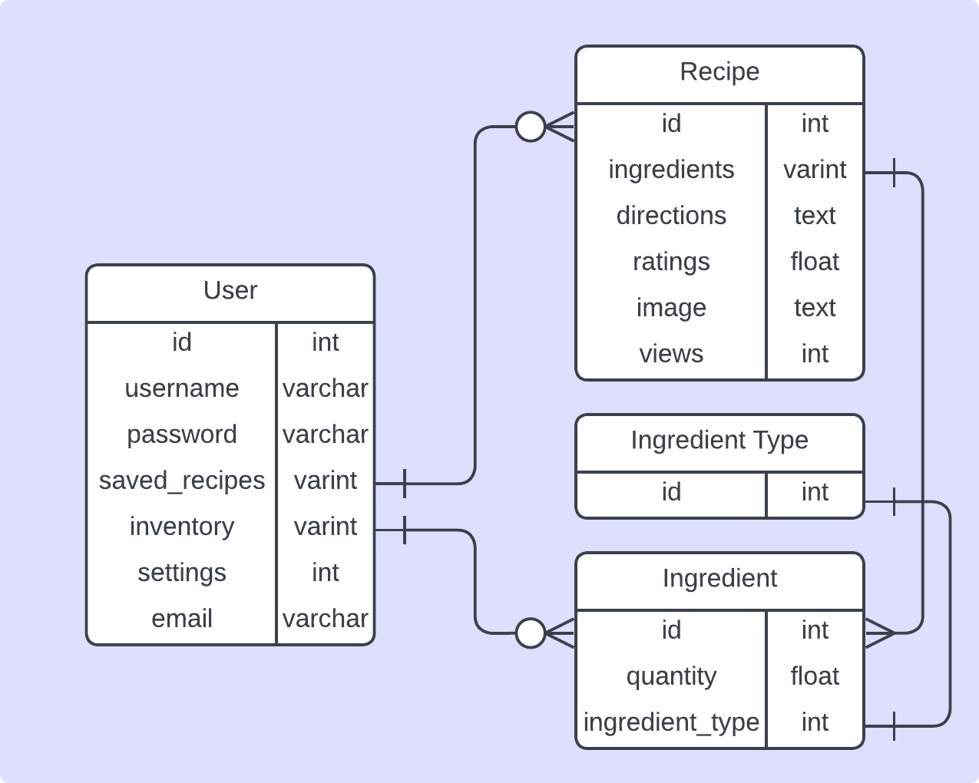
Entity Relationship Diagram
Figure 31. Four Principal Data Types

Slide 23
Design and Testing

Slide 24
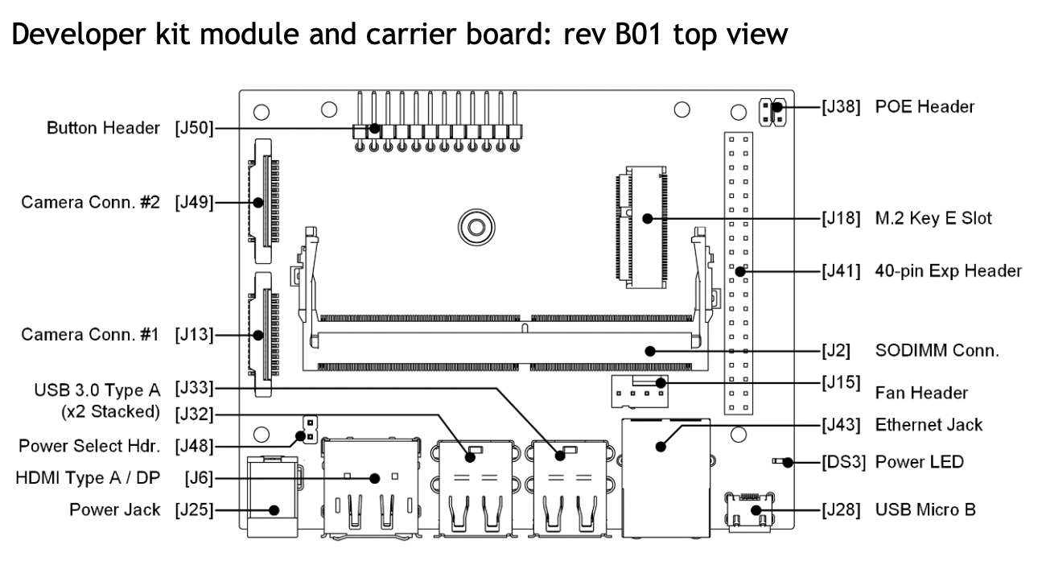
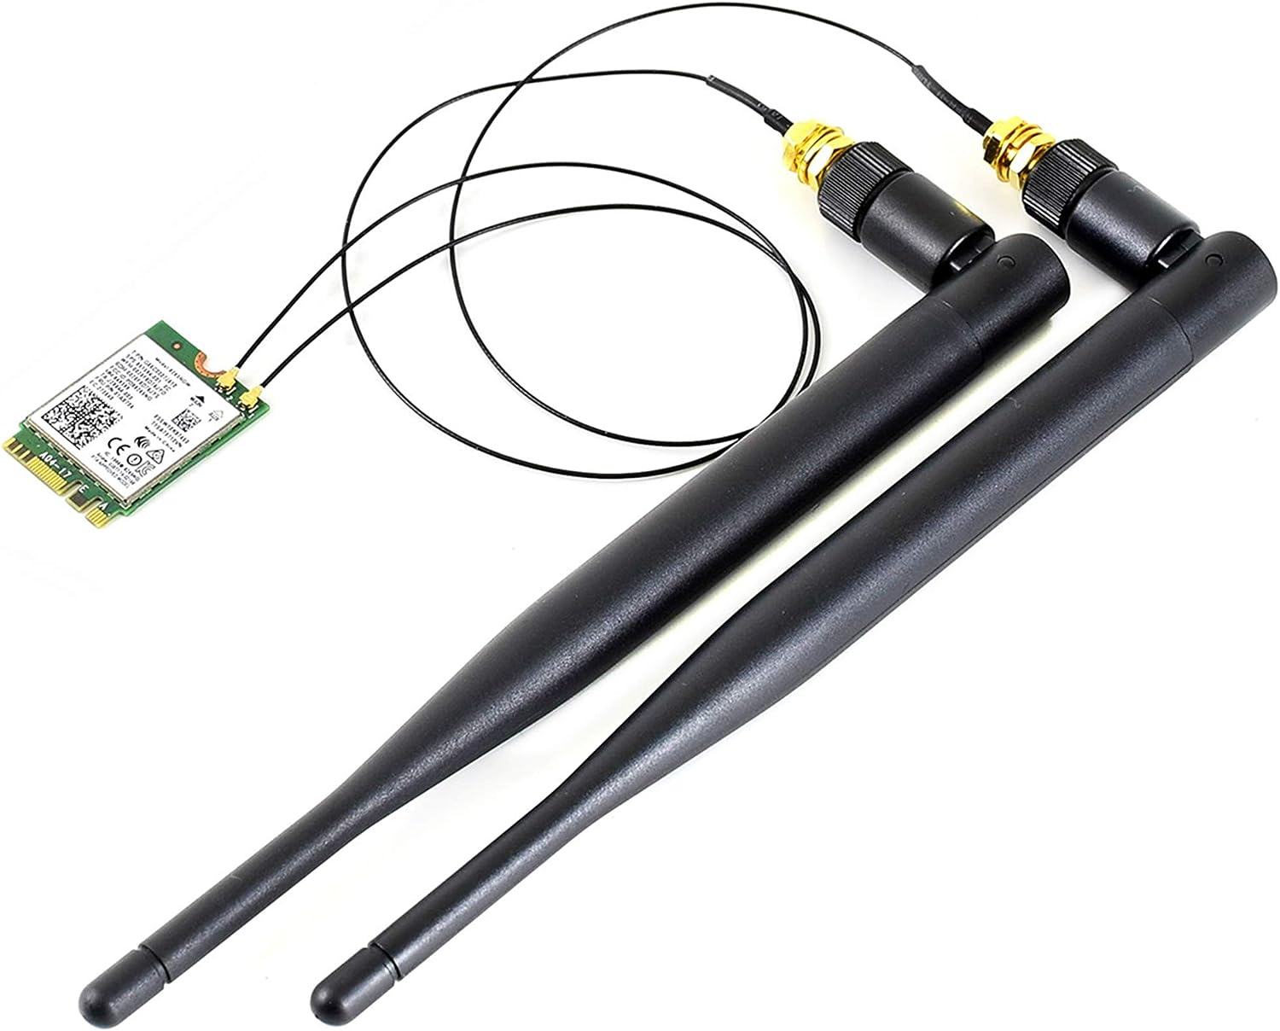
Jetson Nano Carrier Board
Figure 21. Waveshare AC8265 Wireless NIC Module
Figure 20. Jetson Nano Carrier Board Schematic
Notes:
No need to update

Slide 25
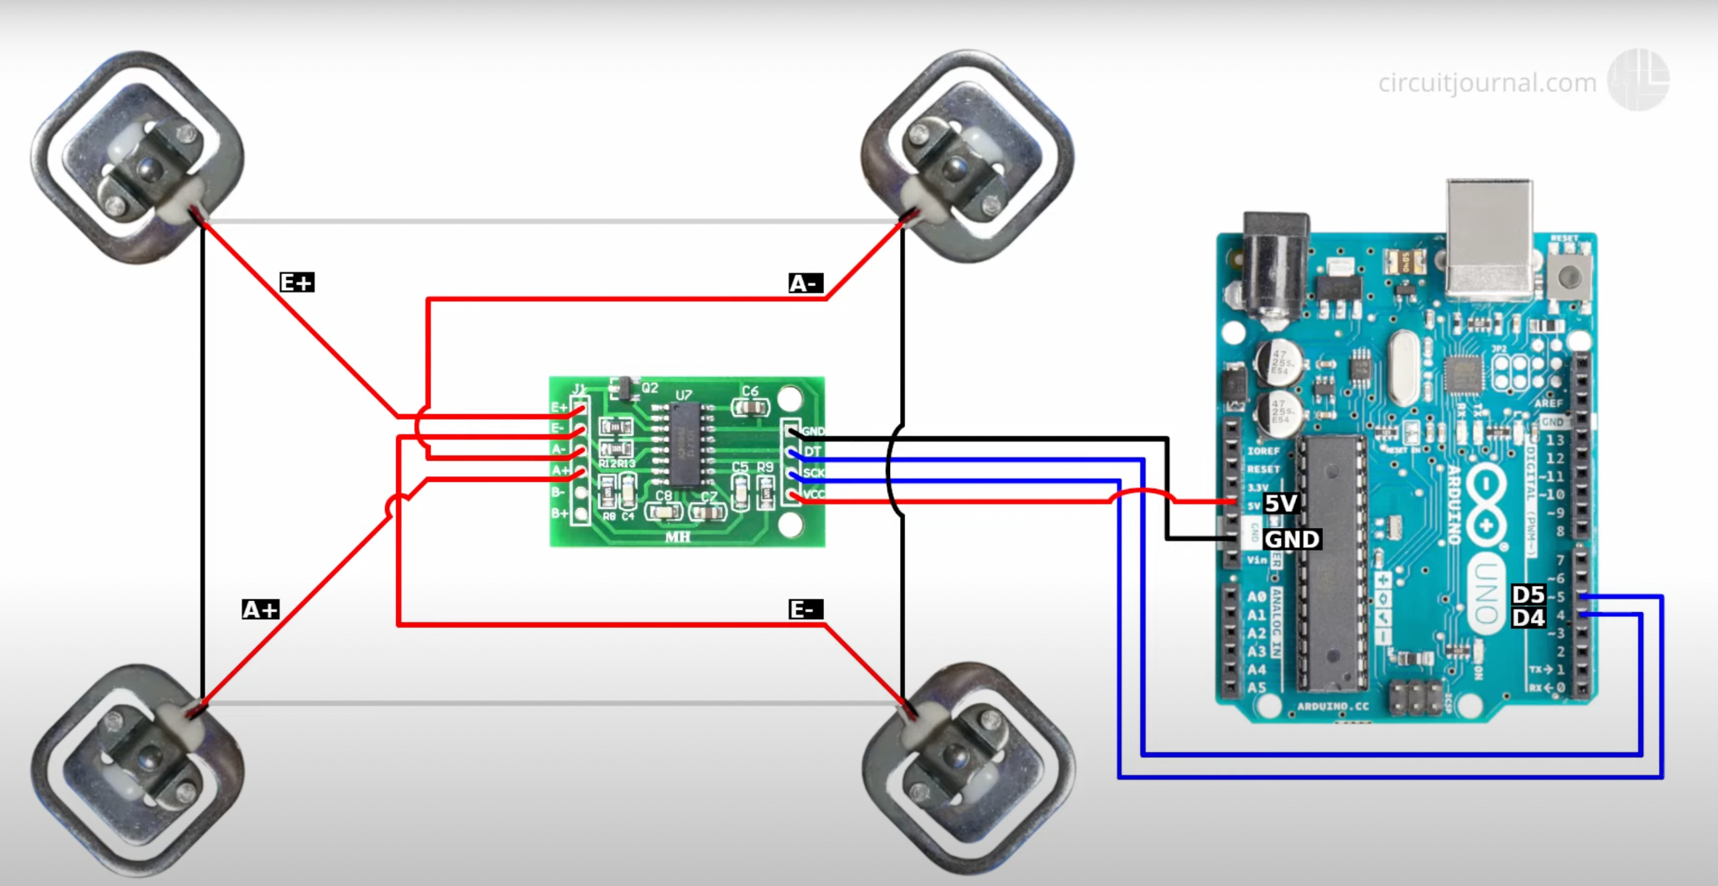
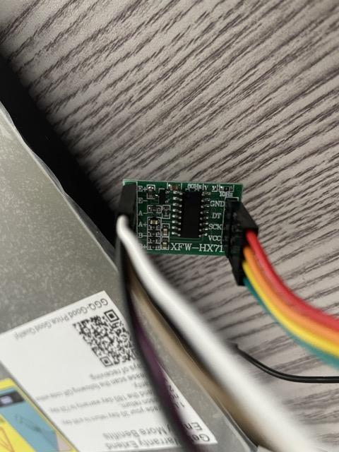
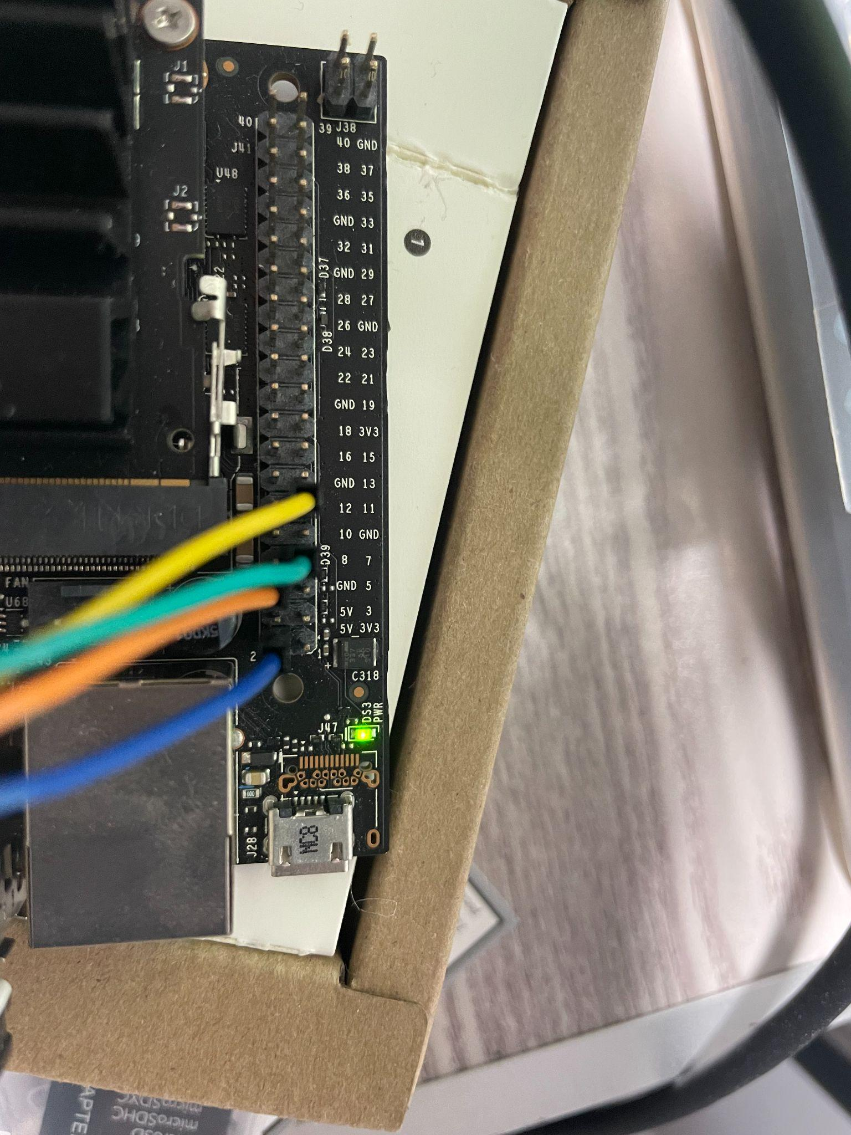
Weight System Integration (1)
Figures 23-24. HX711 Wired to Jetson Nano
Figure 22. HX711 Wiring Diagram. Credits: Indrek Youtube
Notes:
No need to update

Slide 26
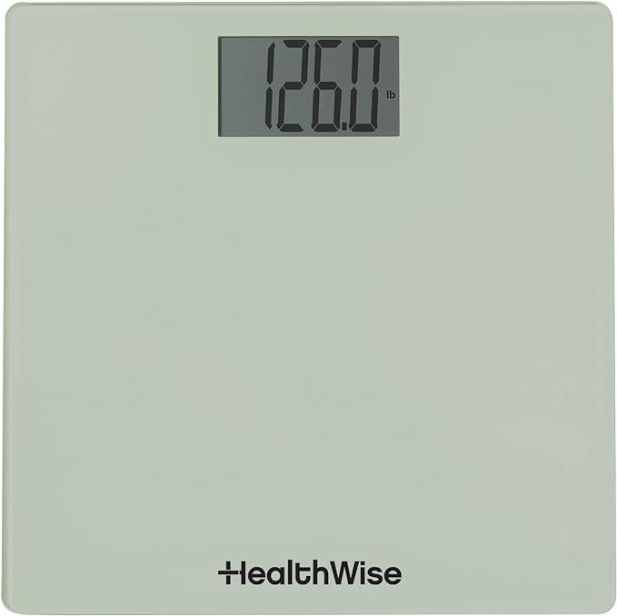
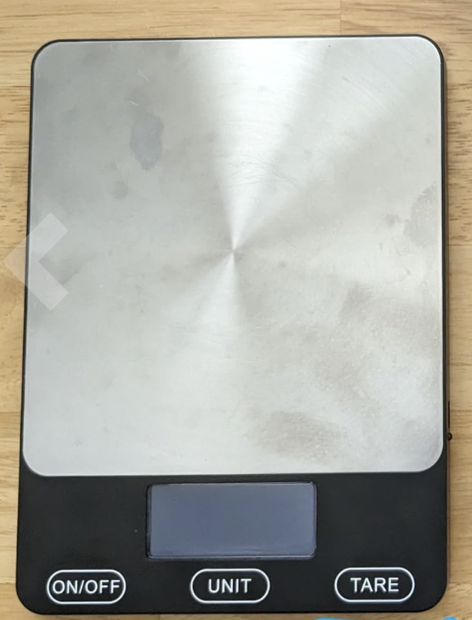
Weight System Integration (2)
Figure 25. Bathroom Digital Scale
Figure 26. Kitchen Digital Scale

Slide 27
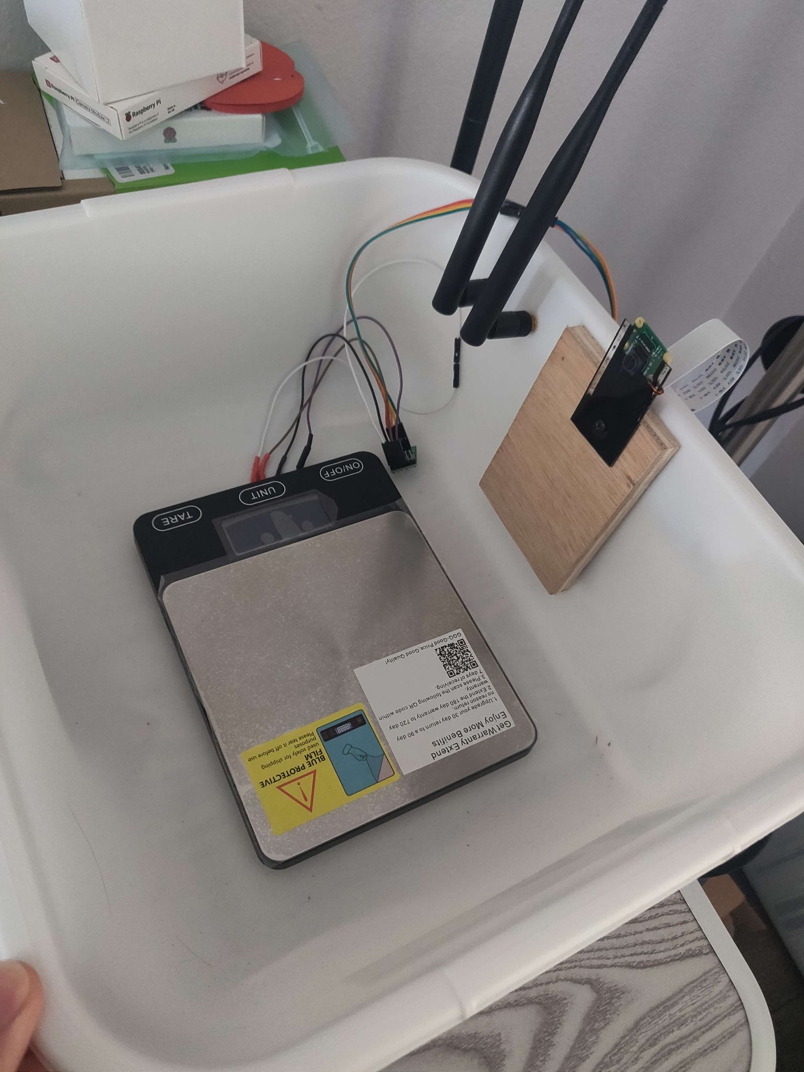
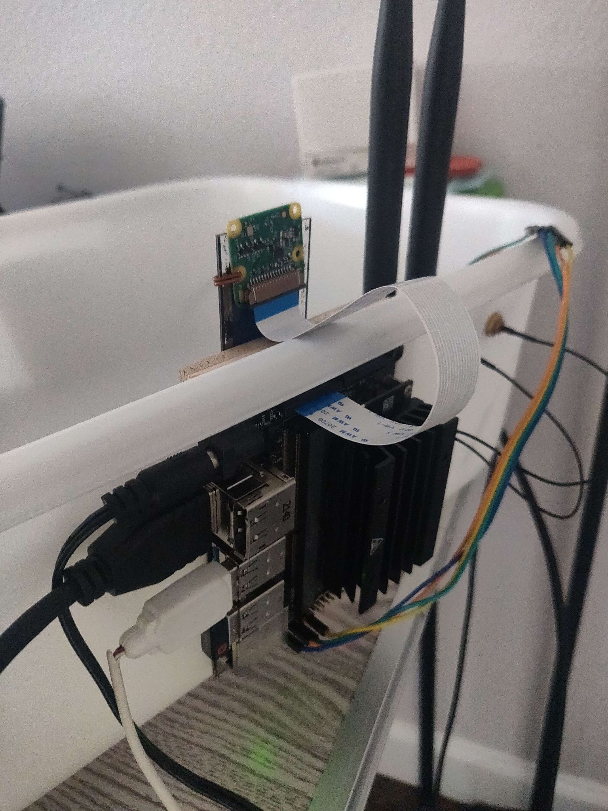
Complete Hardware Assemble

Slide 28
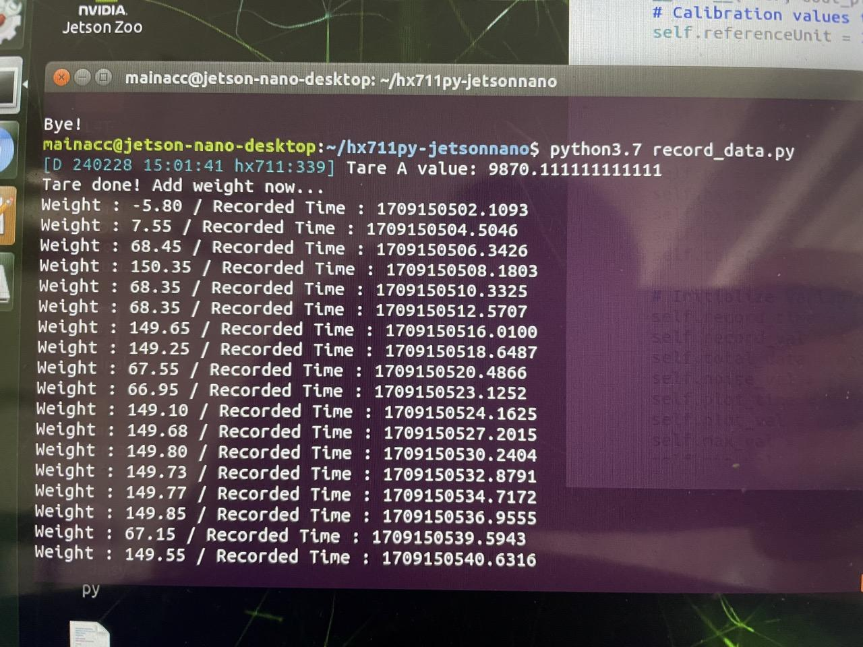
Weight System Integration (3)
Figure 27. Weights Retrieved from HX711
Notes:
Update by mention of weight fluctuation and subsequent decision for deprecation. Requires better sensors which are outside the budget and scope of project

Slide 29
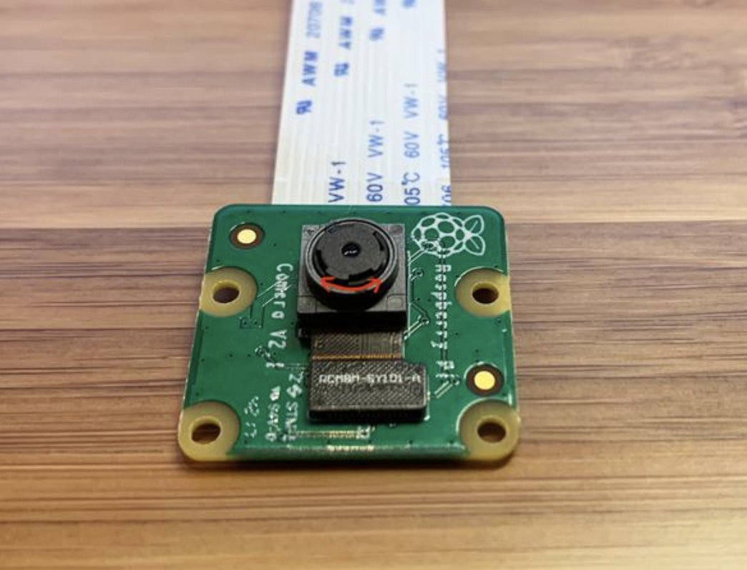
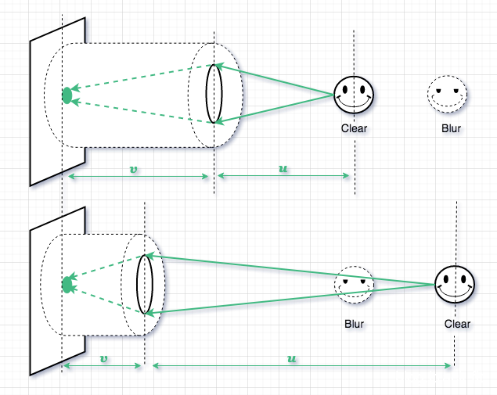
Camera Adjustments
Figure 28. Adjusting Focus Lens on Camera
Figure 29. Focus Lens Diagram

Slide 30
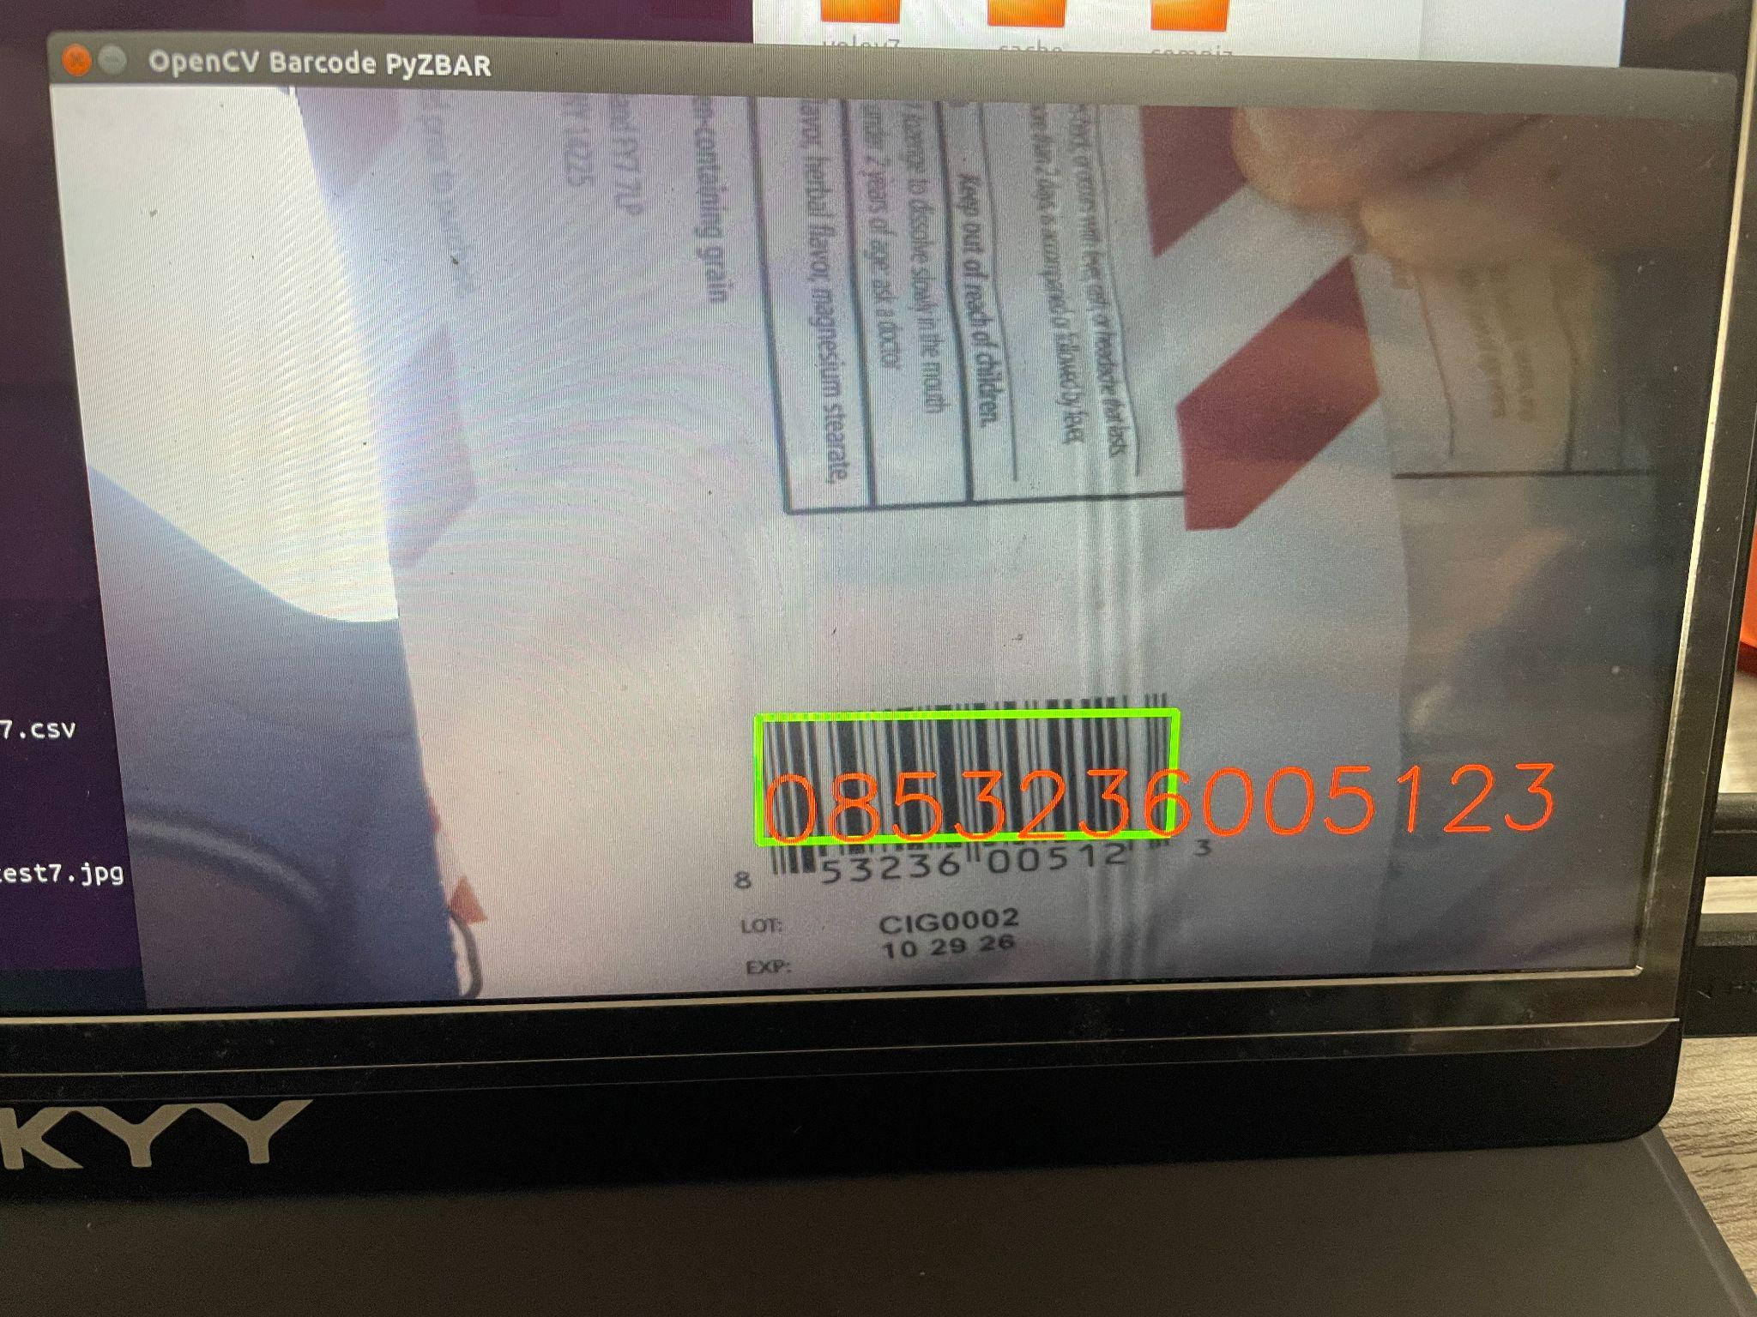
Barcode Detection Testing
Figure 30. PyZBAR Successfully Capturing the Barcode of a Bag of Cough Drops

Slide 31
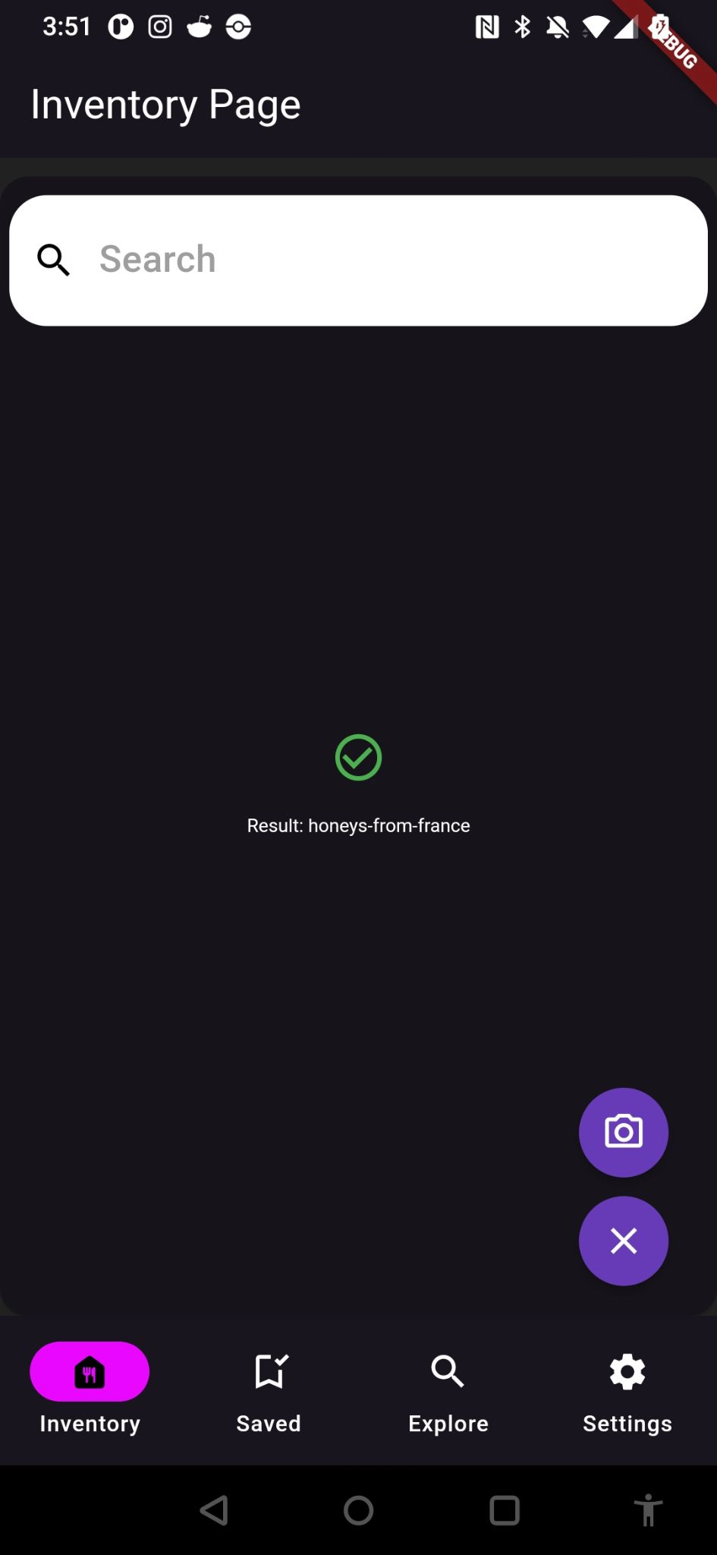
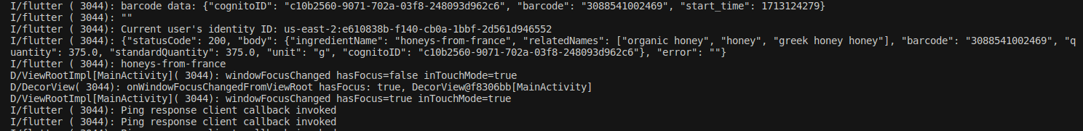
Barcode Detection Pipeline

Slide 32
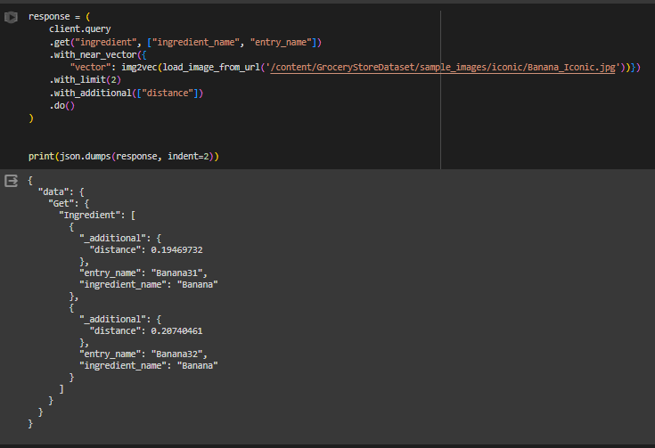
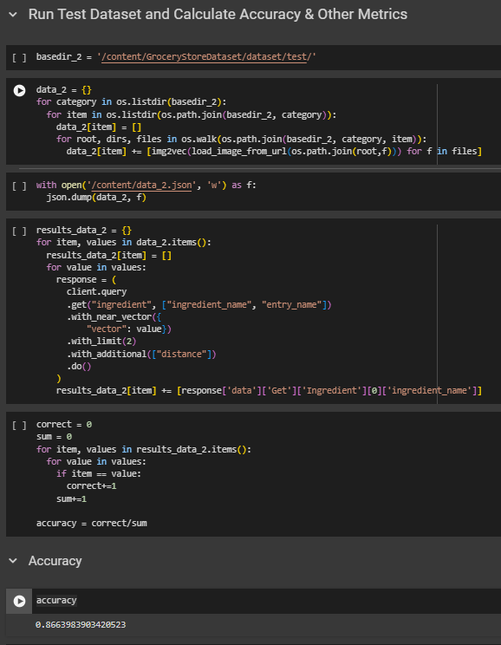

Image Classification Testing

Slide 33
Project Roles and Task Division
Darren Ha
Project Manager
Backend/Frontend
Quan Nguyen
Hardware
Frontend/Backend
Bryan Ha
Machine Learning
Frontend
Weight System Integration and Testing
Primary: Quan Nguyen
Secondary: Darren Ha
Databases
Primary: Darren Ha
Secondary: Quan Nguyen
AWS Amplify and Backend Functions
Primary: Darren Ha
Secondary: Quan Nguyen
Ingredient Detection (barcode and image-based classification)
Bryan Ha
Recipe Recommendation System
Bryan Ha
Mobile UI
Primary: Quan Nguyen
Secondaries: Darren Ha and Bryan Ha

Slide 34
Estimated Overall Bill of Materials
Part Name | Source | Quantity | Price
Rubbermaid White 11.4-Quart Dishpan | Amazon.com | 1 | $12.95
Jetson Nano Developer Kit | Amazon.com | 1 | $149.00
Wireless-AC8265 NIC WiFi and Bluetooth 4.2 Module | Amazon.com | 1 | $24.00
SanDisk 64GB MicroSDXC with Memory Card Adapter | Amazon.com | 1 | $11.70
5V/4A DC Jetson Nano Power Jack | Amazon.com | 1 | $17.00
Raspberry Pi Camera Module 2 | Amazon.com | 1 | $20.00
HX711 Load Cell Amplifier | Amazon.com | 1 | $2.00
HealthWise Digital Bathroom Scale | Amazon.com | 1 | $15.00
Jump Wire Kit | Home | 1 | $0.00
Basic Soldering Kit | Home | 1 | $0.00
Hardware Design Subtotal: |  | $265.60
AWS Amplify Services | Amazon Web Services | — | $12.00*
UPC Database Service | upcdatabase.org | — | $10.00
GRAND TOTAL: |  | $263.65

Slide 35
Results
Hardware
Mounted all the components onto the container
Integrated weight system
Integrated barcode-detection + object detection
Backend
Setup and connect Weaviate Vector Database
Populate recipe and user tables in DynamoDB
Functioning barcode detection software
image-based ingredient classification software performs at 85% accuracy
Create Lambda Functions to run ML code and serve as API
Functioning recipe recommendation system that parses existing inventory and diet-type/avoidance options
Frontend
Implemented Flutter-based UI pages
Integrate with ML and AWS Amplify backend to broadcast backend/hardware-processed info

Slide 36
Product: The Good and The Bad
Good:
Functional front-end that display scanned / pictured ingredients for process
Completed backend processes scanned barcodes into product name and quantity
Vectorized images sent through KNN model as vectors to produce name classification with high confidence
Bad:
Need to fully integrate all backend function to the front end
Better UI design
More theme functions to cater to the user preference

Slide 37
Project: pros and cons
Pros:
Very fast front-end + api development stage (2 weeks)
Learned completely new technologies
All backends performed with relatively high quality
Cons:
Weight integration system took most of development time + not part of product
Git conflicts

Slide 38
Questions

